Slide 1

Project on National Data Portals in Samoa and Fiji Workshop 2 Experience Sharing and SDMX/.Stat Suite Tools 27-31 January 2025 Suva, Fiji
FMR Workbench: Overview

Slide 2


Learning objectives
At the end of this session, you will be able to:
Navigate the interface of FMR wb
Jump from the .Stat suite DLM to FMR wb

Slide 3
Outline
Intro to the Fusion Metadata Registry
Fusion Metadata Registry and FMR workbench
FMR workbench components
FMR workbench and the .Stat Suite DLM

Slide 4
https://stats-test-fwb.pacificdata.org/

Slide 5
Fusion Metadata Registry
a structural metadata registry:
a database designed specifically for storing SDMX artefacts including Concepts, Codelists, Data Structure, and Data Flows definitions
It supports EDI, SDMX 1.0, 2.0, 2.1 and 3.0
Many services (data validation, transformation, conversion, API, …)

Slide 6
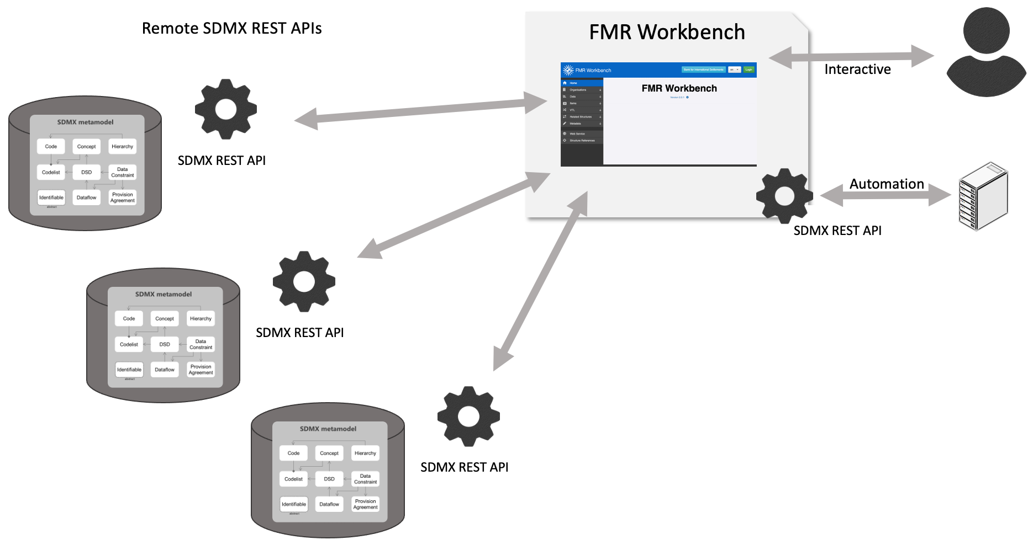
FMR Workbench
A maintenance tool for SDMX structural metadata, built on the Fusion Metadata Registry web interface.

Slide 7
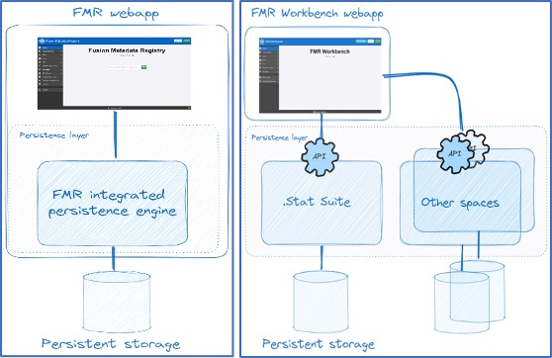
FWB vs. FMR
same SDMX structural metadata registry engine.
same UI.
FWB supports viewing and maintaining structural metadata. No data validation, conversion, mapping and administration.
FMR is self contained. FWB connects to and acts upon .Stat Suite .
FMR uses configuration is in a database. FWB configuration is stored in a file.

Slide 8

FWB vs. FMR
both developed by the Bank for International Settlements

Slide 9
FMR Workbench
User-Friendly.
Suitable for non-SDMX Experts as well as Experts.
Wizard mode.
Manual manipulations.

Slide 10
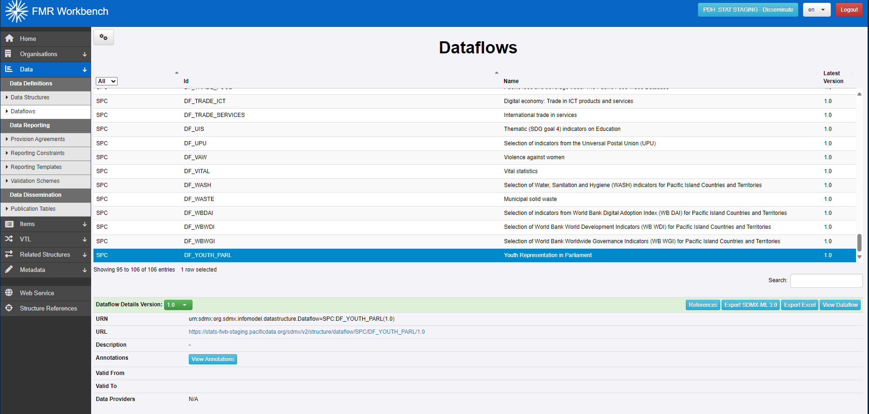
FMR Workbench

Slide 11

FMR Workbench
The UI of the FMR Workbench enables the user to switch their connection to an alternative Environment; the list of available Environments is defined in the configuration file for the FMR Workbench.

Slide 12
FMR Workbench
Select different artefact types
+
Useful tools

Slide 13
FMR Workbench
Identify related structures
Build API calls
Find structures referenced by something else

Slide 14

FMR Workbench
Create, edit, delete structure; manage annotations.
List artefacts of a certain type
Search artefact by keywords

Slide 15


FMR Workbench
Details of selected artefact
Available actions

Slide 16

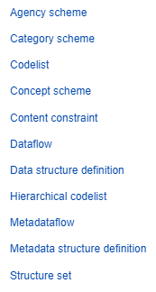
FMR in .Stat DLM
Creates SDMX artefacts in this .Stat space

Slide 17
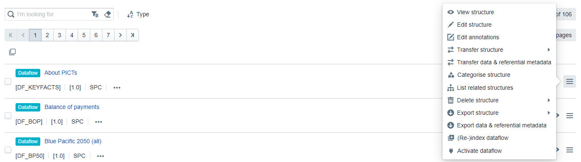
FMR in .Stat DLM
View / Edit structure + Edit annotations in FWB

Slide 18
Exercise
Navigate to the FMR knowledge bank fmrwiki.sdmxcloud.org
Find documentation for FMR workbench and FMR

Slide 19
Discussion and Q&A

